Slide 1
Script Analyzer
- Chinmay Rajguru
- Shanmukha Agastyaraju

Slide 2


OUTLINE . . .
Problem
Solution
Demo
Technical Details
Vision & Future Perspectives

Slide 3
Importance
Interpretation of Script
Analysis of a input data for detection of vulnerability in script
Applications
Make Script stronger
Provide security hints to programmer
Overcome the issues which are easily visible

Slide 4
Problem ?
Scripts without Script Analyzer:
Vulnerable to threat
Ignored Security issues
Prone to get hacked

Slide 5
Solution
Use Script Analyzer
Big Dataset of most common vulnerabilities
Python 2.7

Slide 6
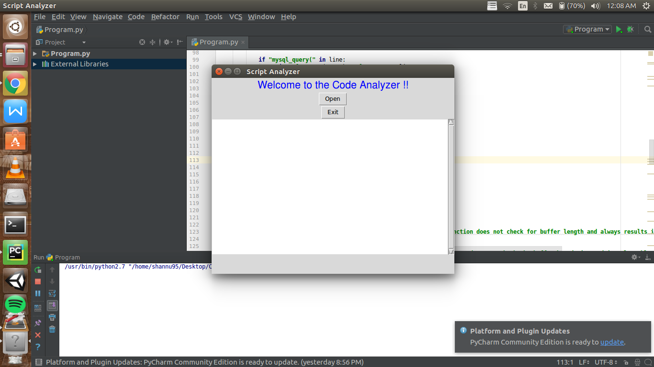
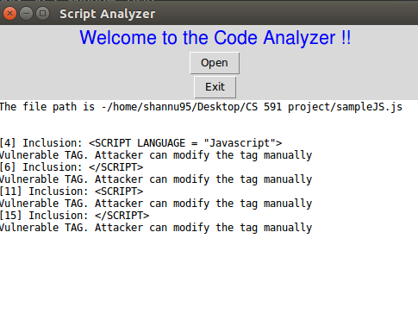
How It Works
Give Input of .JS / .PHP / .CPP / .CS / .JAVA file
System reads the script line by line
Compares every line with given dataset
Get output as line number, vulnerable script and it’s reason and possible solution

Slide 7
Demo

Slide 8
Technical Details
JavaScript :
Detecting statements involving
Cookies
JDBC
URL “src”
XSS

Slide 9
Technical Details
PHP :
Detecting statements involving
passthru()
fwrite()
shell_exec()
glob()
popen()

Slide 10
Technical Details
Detecting statements for :
C++ :
strcpy()
sprintf(), fprintf(), snprintf()
C# :
JDBC select statement
LDAP injection
Java :
SQL injection
URL tampering

Slide 11
Vision & Future Perspective
To learn implementation of Script Analyzer for multiple languages
Future possible modifications:
Store dataset on cloud, to make the system more mobile to use
System modifies the scripts and provides to user

Slide 12
ANY
QUESTIONS?

Slide 13

THANK YOU

